Slide 1
EEET2449 Research Methods for Engineers
Lecture 9: Patents
Dr Francisco Tovar
Email: francisco.tovarlopez@rmit.edu.au
Prof Arnan Mitchell
Email: arnan.mitchell@rmit.edu.au

Slide 2
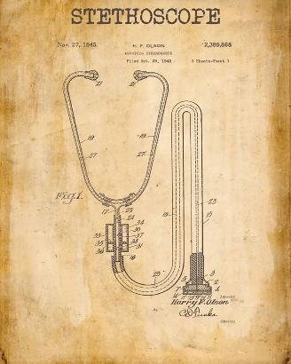
Patents – what are they ?
Records of inventions involving an inventive step not obvious to experts in the field.
A patent gives you certain legal rights, which can deter rival businesses from using or copying your products or inventions.
Patents were created to try to encourage people to publish
(alternative is just to keep something secret), with the incentive
of legal protection.
Accelerate innovation:
Make new technology available to researchers as it is invented.
A positive feedback loop. More inventions, more innovation.
2016
khashayar.khoshmanesh@rmit.edu.au

Slide 3
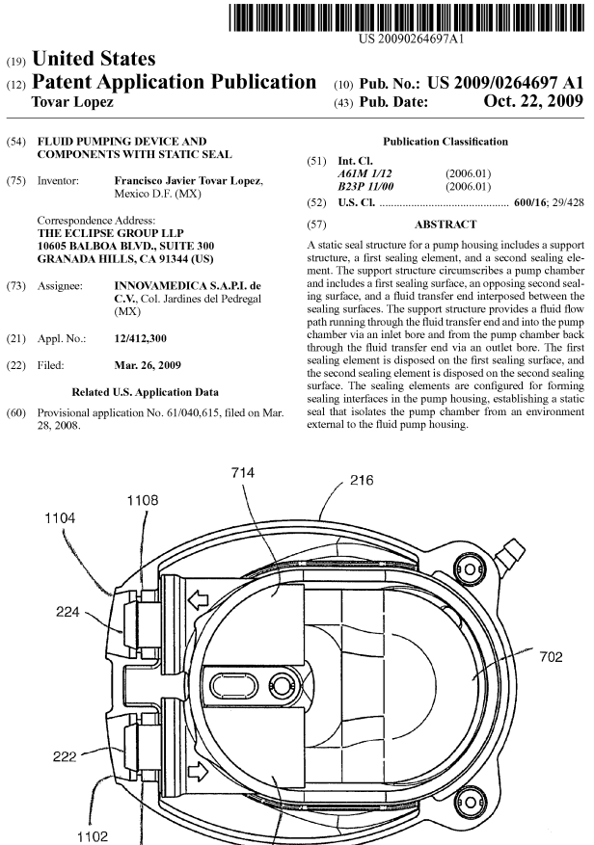
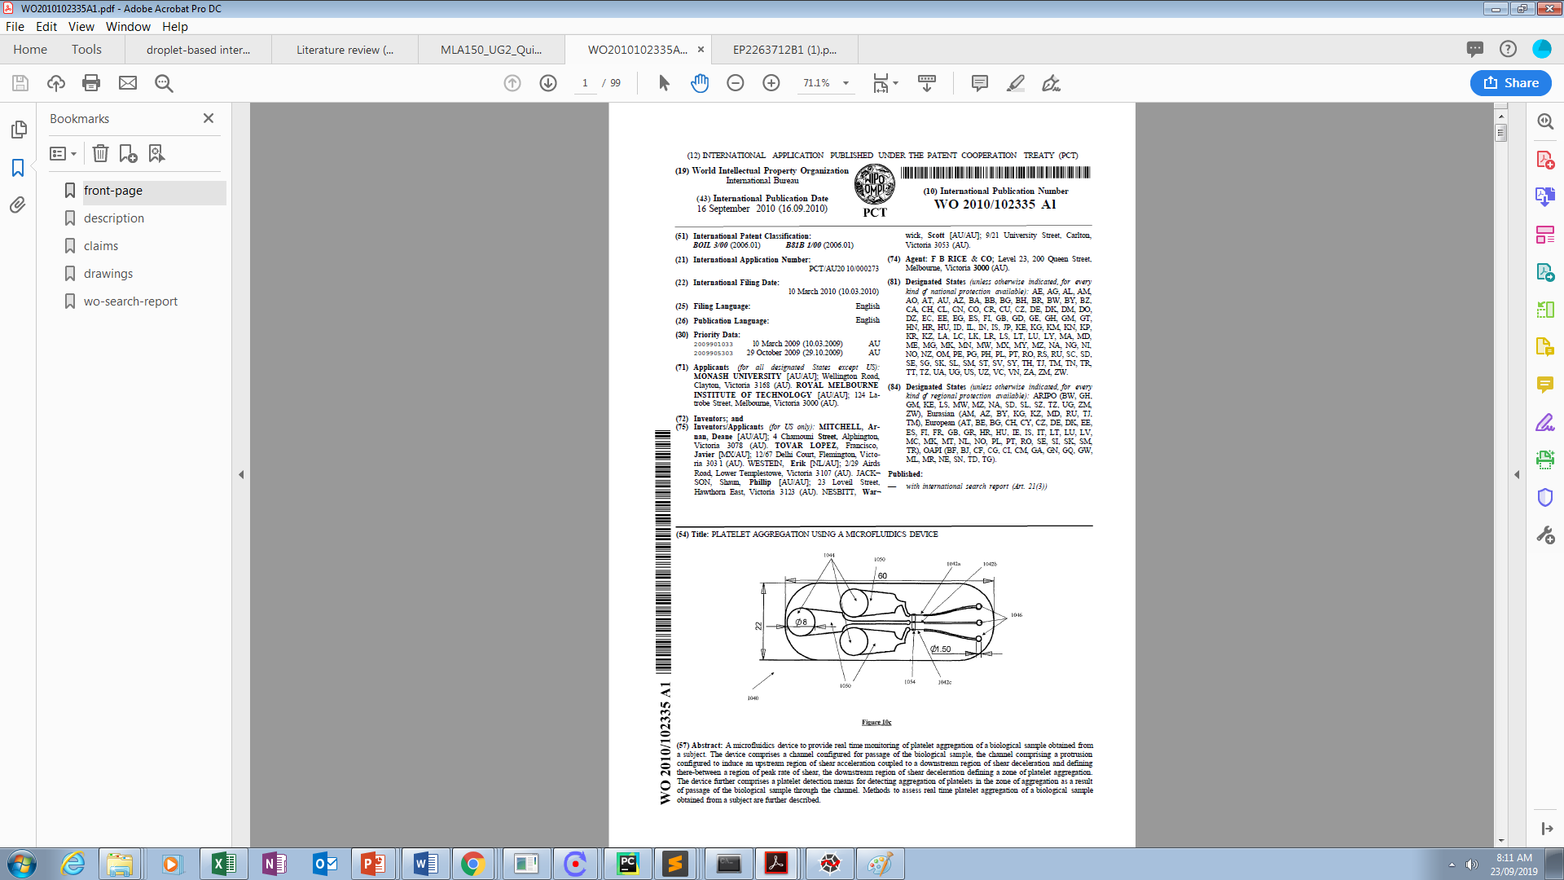
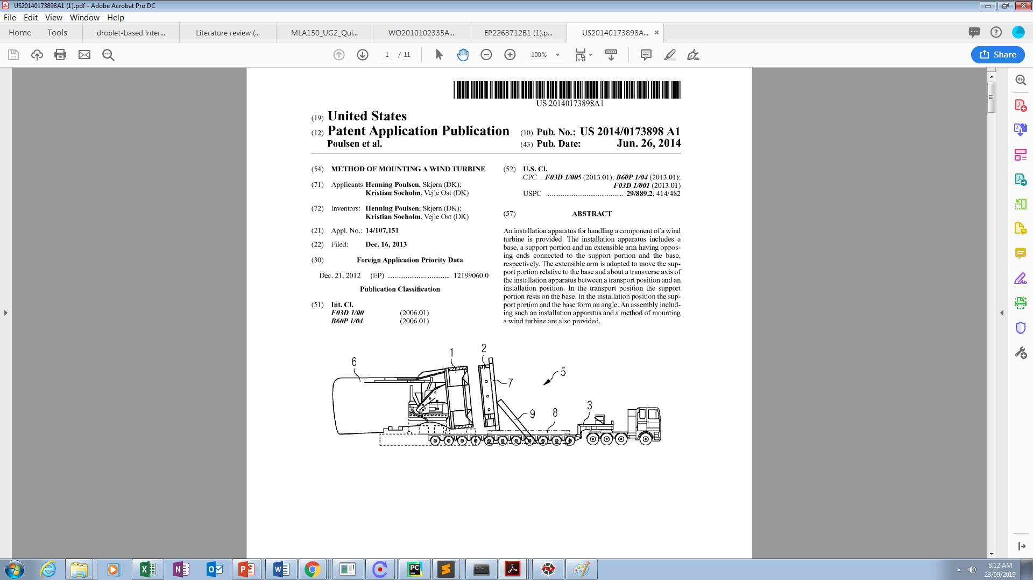
Patents – what are they ? A few examples
A device solving a problem from industry
A device related to a recent high profile publication / discovery
A method

Slide 4
How many patents ?

Slide 5
How many patents ?

Slide 6
How many patents ?
Big companies file 100’s to 1000’s of patents each year
At $50,000 each, that is $5-50M in filing costs alone (on top of cost of research!)

Slide 7
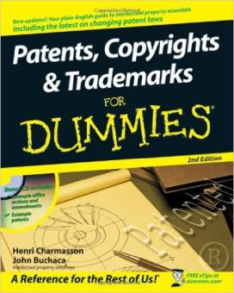
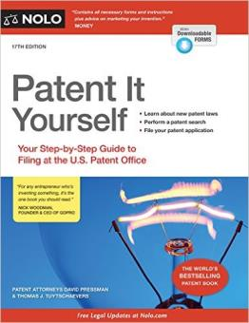
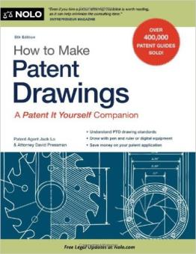
How do you get a patent ?

Slide 8
How do you get a patent ?
Come up with an idea (something novel)
Assess idea for commercial potential (patents are expensive – need to be confident of path to commercialisation)
Patent: Submit provisional application (more on next slides)
Prototype: Build working model that will excite customers
Publish: publish paper, promote at conferences, go to customers

Slide 9
How do you get a patent ? (and why data management is so important)
Requirements for Patent
The invention must be useful (subjective)
It must be novel (no prior art)
It cannot be obvious (to an expert)
Must be described such that skilled people in the relevant field can understand it, make it and use it (reducible to practice)
Keeping records is essential to prove prior art
Records are also essential to prove inventorship
Patents can be invalidated or protected on the basis of poor/good records (can mean a lot of money!)
Watch this clip:
http://willblogforfood.typepad.com/will_blog_for_food/2007/12/philo-t-farnswo.html
https://www.youtube.com/watch?v=diyK01RUuAo

Slide 10

How to get a patent ?
http://www.ipaustralia.gov.au/get-the-right-ip/patents/

Slide 11
How to get a patent ?
Apply for a standard patent
(20 years)
File a provisional application
(12 months)
Apply for an innovation patent
(8 years)
Invention
Apply for an international patent
(18 months)
Apply for a
national patent
in other countries
(20 years)

Slide 12
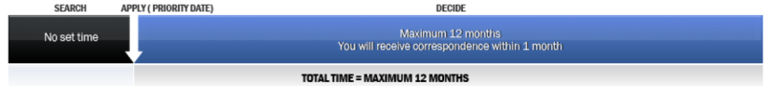
How to file a provisional application (in Australia) ?
Search Apply Decide
http://www.ipaustralia.gov.au/get-the-right-ip/patents/patent-application-process/patent-overview-provisional/
Search
if there is anything similar in the market?
Apply - to set a priority date
- does not offer any patent protection on its own
Decide within 12 months
- you need to file an International, Standard or Innovation patent application within 12 months

Slide 13
How to get a patent ?
Apply for a standard patent
(20 years)
File a provisional application
(12 months)
Apply for an innovation patent
(8 years)
Invention
Apply for an international patent
(18 months)
Apply for a
national patent
in other countries
(20 years)

Slide 14
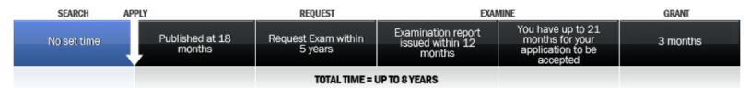
How to get a standard patent (in Australia) ?
Search Apply Publish Request Examination Responding Publish Grant
http://www.ipaustralia.gov.au/get-the-right-ip/patents/patent-application-process/patent-overview-provisional/
Search
if there is anything similar in the market?
you might have done this for your provisional application
Apply - to set a priority date
Publish in the Australian Official Journal of Patents
complete application is published in the Australian Official Journal of Patents 18 months from the priority date

Slide 15
How to get a standard patent (in Australia) ?
Search Apply Publish Request Examination Responding Publish Grant
http://www.ipaustralia.gov.au/get-the-right-ip/patents/patent-application-process/patent-overview-provisional/
Request examination
You must request examination within 5 years of filing your application
If you do not request examination your application will lapse

Slide 16
How to get a standard patent (in Australia) ?
Search Apply Publish Request Examination Responding Publish Grant
http://www.ipaustralia.gov.au/get-the-right-ip/patents/patent-application-process/patent-overview-provisional/
Examination
Your application will be examined mainly based on:
novelty
the presence of an inventive step
is something that can be patented
Responding to objections
These objections need to be addressed within 21 months of the examination report date.

Slide 17
How to get a standard patent (in Australia) ?
Search Apply Publish Request Examination Responding Publish Grant
http://www.ipaustralia.gov.au/get-the-right-ip/patents/patent-application-process/patent-overview-provisional/
Publish in the Australian Official Journal of Patents
The accepted application is then published in the Australian Official Journal of Patents.
Oppose by third parties
Third parties have a period of 3 months to oppose your application.
If an opposition is received, the issues may take time to be resolved!!

Slide 18
How to get a standard patent (in Australia) ?
Search Apply Publish Request Examination Responding Publish Grant
http://www.ipaustralia.gov.au/get-the-right-ip/patents/patent-application-process/patent-overview-provisional/
Grant
Your patent will be granted if no oppositions have been filed or once oppositions have been settled.
Once your patent is granted and all fees are paid, it will be protected for 20 years.
An annual fee must be paid for the duration of the patent

Slide 19
Difference between standard and innovation patent
Standard: Your invention will involve an inventive step unless the invention would have been obvious to a person skilled in the relevant field in the light of common general knowledge alone, or in combination with one or more prior art documents.
Innovation: Your invention will involve an innovative step unless a person skilled in the relevant field (in the light of common general knowledge) would consider the invention only varied from what is already known in ways that make no substantial contribution to the working of the invention. In other words your invention must be different (i.e. novel) to what is already known and those differences must make a contribution to the working of an invention. You should consider applying for an innovation patent when your invention is a relatively small improvement upon the working of an invention that already exists.
The innovation patent is a relatively inexpensive form of IP protection
It is quick and easy to obtain for inventions that have a short commercial life
or that offer comparatively small advances over existing technology
An innovation patent is protected for only 8 years.

Slide 20
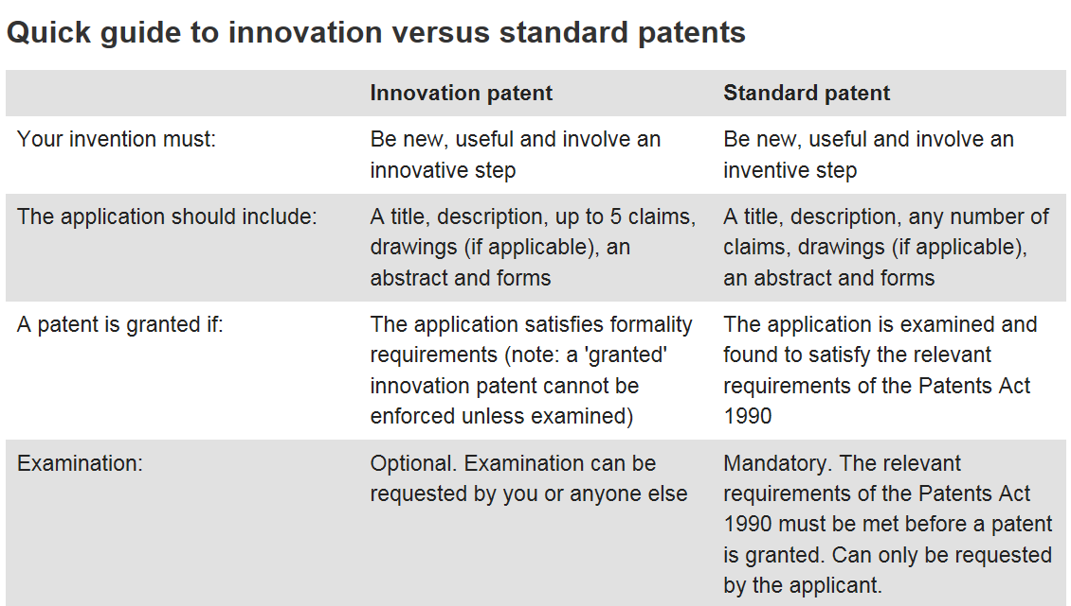
Difference between standard and innovation patent
http://www.ipaustralia.gov.au/get-the-right-ip/patents/types-of-patents/standard-vs-innovation-patent/

Slide 21
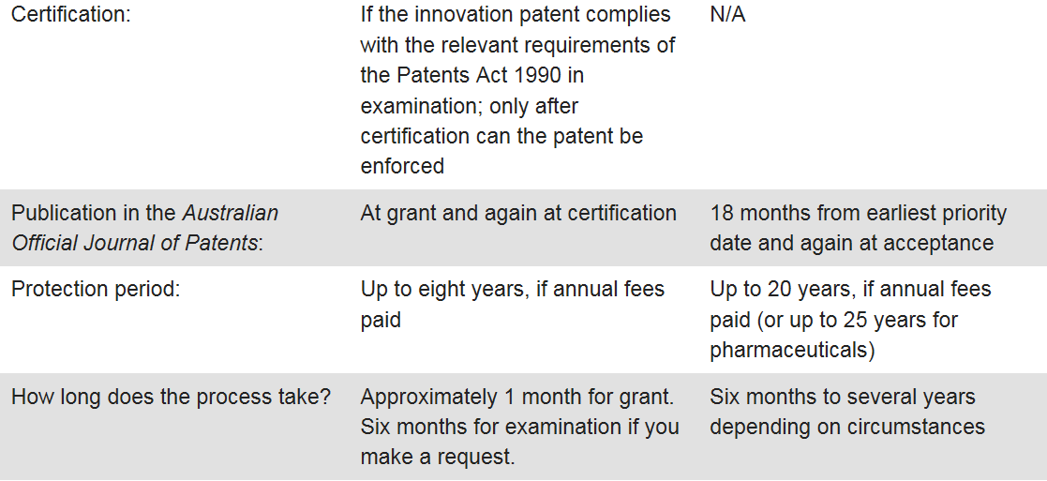
Difference between standard and innovation patent

Slide 22
How much will it cost ?
Factoring cost of experts (lawyers, consultants etc.) Typically, for a single idea:
A provisional patent applications can range between $3,300 and $7,000
An Innovation patent application can range between $3,000 and $6,000
A PCT international patent application can range between $9,000 and $15,000
The amount quoted will depend on technology, complexity, level of detail required and timeframe.
You need to team up with investors.

Slide 23
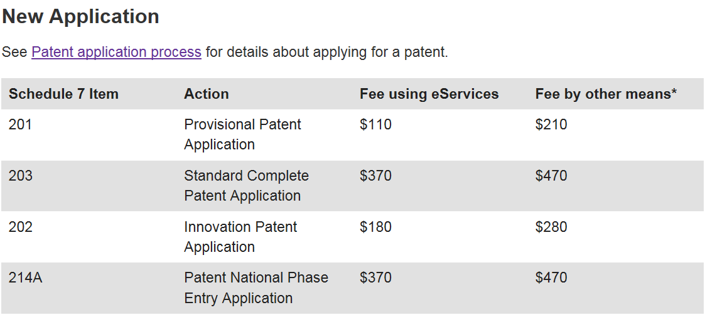
How much will it cost ?
http://www.ipaustralia.gov.au/get-the-right-ip/patents/time-and-costs/fees/

Slide 24
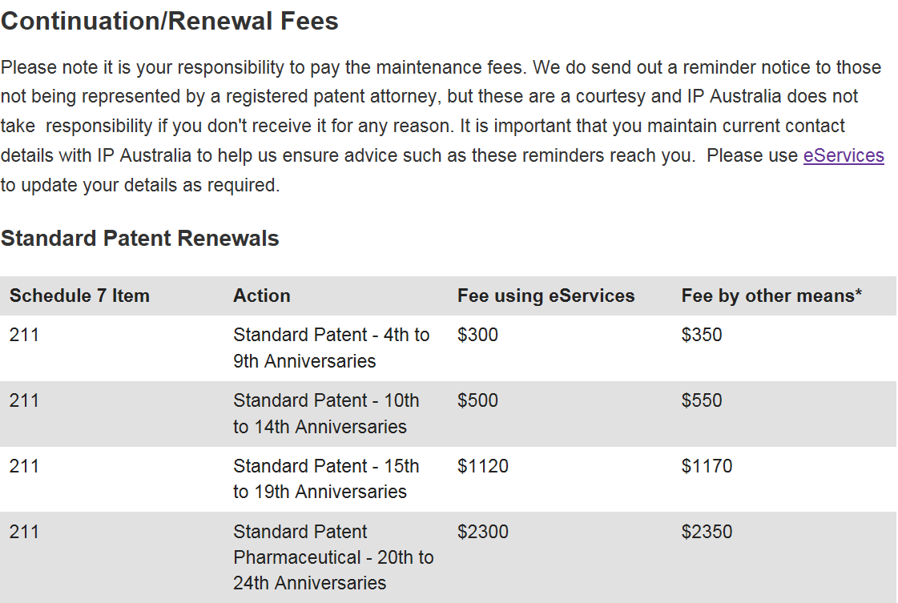
How much will it cost ?
http://www.ipaustralia.gov.au/get-the-right-ip/patents/time-and-costs/fees/

Slide 25
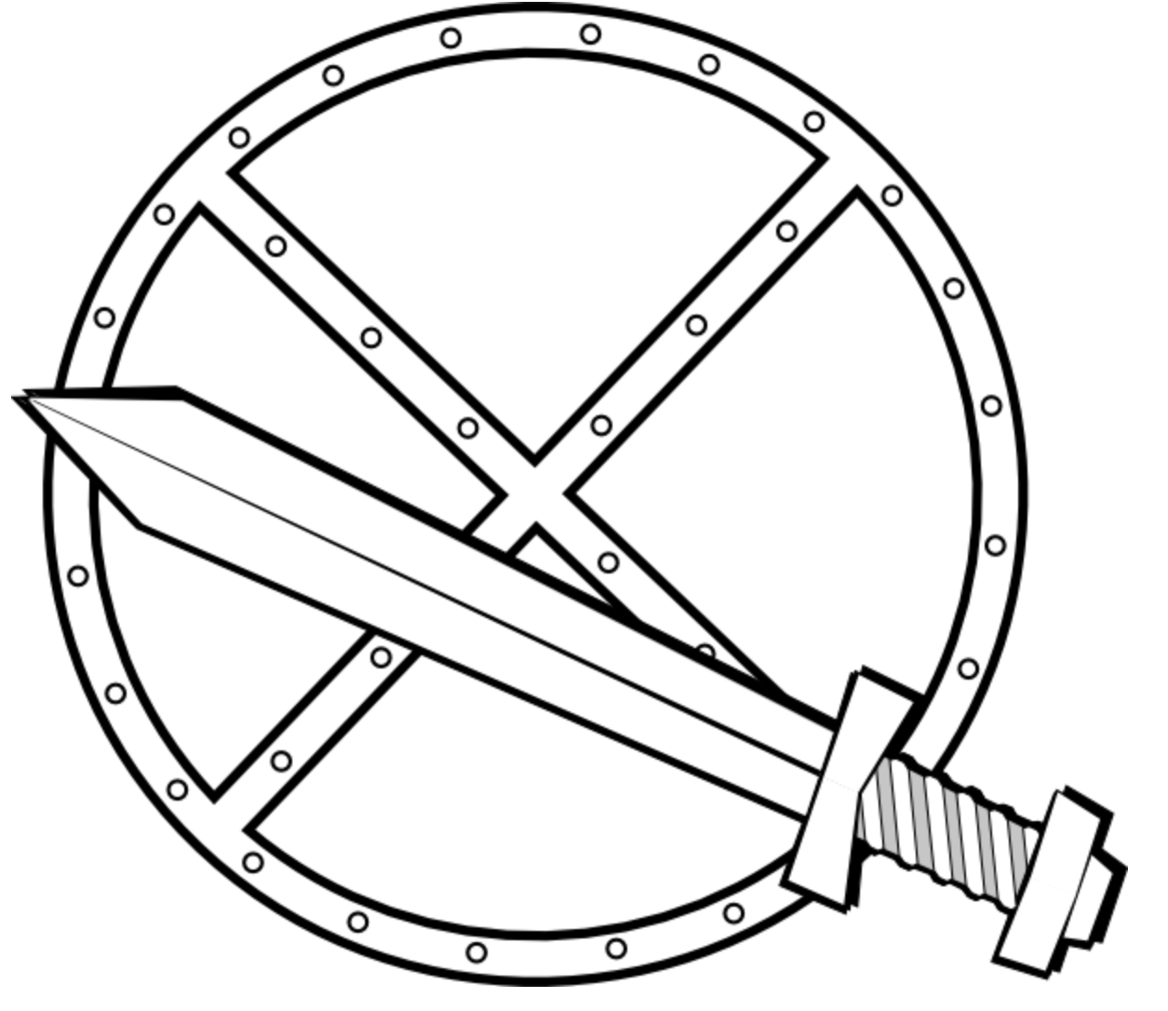
How do you make money out of a patent? (not really my expertise – but my opinion anyway!)
Customers do not come to you (you need to go to them)
Start with a business plan
Patent is part of business plan (not business plan element of patent)
Invest in a professional (money well spent – if a trusted expert)
Patents are tools (will only make money if you know how to use them)
Some options:
Build Start-Up Company (and then get bought out)
Need many (20+) patents to be credible player
Competitor needs to believe you will go to market and compete
Long term strategy (5 years) and expensive ($10M investment)
During Tech ‘Boom’ 1999 - Company valuation 1 Patent = $1M
License/sell patent direct (simple, quick, but careful not to tip them off!)

Slide 26
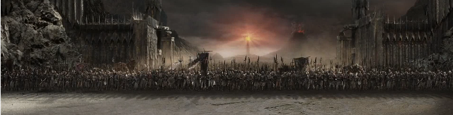
How do you make money out of a patent? (not really my expertise – but my opinion anyway!)
Companies have patent ‘maps’ (identifying areas that they want to have a market)
Deliberately patenting in particular spaces (to maximise intersection with competitors)
When your competitor declares war … (have your own cache of patents to counter-sue)
Buy small start-up companies for their patents (can be effective way to bulk up in a particular area quickly)

